Slide 1


Microsoft SQL Server
Microsoft SQL Server is a relational database management system developed by Microsoft in 1989. As a database server, it is a software product with the primary function of storing and retrieving data as requested by other software applications—which may run either on the same computer or on another computer across a network (including the Internet).

Slide 2
Versions of SQL Server
VERSION | RELEASE DATE | RELEASE NAME
1.0 (OS/2) | 1989 | SQL Server 1.0 (16-bit)
1.1 (OS/2) | 1990 | SQL Server 1.1 (16-bit)
4.2A (OS/2) | 1992 | SQL Server 4.2A
4.2B (OS/2) | 1993 | SQL Server 4.2B (16-bit)
4.21a (WinNT) | 1993 | SQL Server 4.21a
6.0 | 1995 | SQL Server 6.0
6.5 | 1996 | SQL Server 6.5
7.0 | 1998 | SQL Server 7.0
8.0 | 2000 | SQL Server 2000
8.0 | 2003 | SQL Server 2000 64-bit Edition

Slide 3
VERSION | RELEASE DATE | RELEASE NAME
9.0 | 14 January 2006 | SQL Server 2005
10.0 | 6 November 2008 | SQL Server 2008
10.25 | 2010 | Azure SQL database (initial release)
10.50 | 20 July 2010 | SQL Server 2008 R2
11.0 | 20 May 2012 | SQL Server 2012
12.0 | 2014 | Azure SQL database
12.0 | 5 June 2014 | SQL Server 2014
13.0 | 1 June 2016 | SQL Server 2016
14.0 | 29 September 2017 | SQL Server 2017
15.0 | 4 November 2019 | SQL Server 2019

Slide 4
Data Types in SQL

Slide 5
What is a Datatype? A Datatype is used to define the type of data to be used by the column. SQL Server has a predefined set of datatypes.
SQL Server | Data Precision
BIT | Integer: 0 or 1
TINYINT | Positive Integer 0 -> 255
SMALLINT | Signed Integer -32,768 -> 32,767
INT | Signed Integer -2^31 -> 2^31-1
BIGINT | Signed Integer -2^63 -> 2^63-1
REAL | Floating precision -1.79E + 308 -> 1.79E + 308
FLOAT | Floating precision -3.40E + 38 -> 3.40E + 38
MONEY | 4 decimal places, -2^63/10000 -> 2^63-1/10000
SMALLMONEY | 4 decimal places, -214,748.3648 -> 214,748.3647
DECIMAL | Fixed precision -10^38 + 1 -> 10^38 – 1
NUMERIC | Fixed precision -10^38 + 1 -> 10^38 – 1
DATETIME | Date+Time 1753-01-01 -> 9999-12-31, accuracy of 3.33 ms
SMALLDATETIME | Date+Time 1900-01-01 -> 2079-06-06, accuracy of one minute
CHARn | Fixed-length non-Unicode string to 8,000 characters
NCHARn | Fixed-length Unicode string to 4,000 characters
VARCHARn | Variable-length non-Unicode string to 8,000 characters
NVARCHARn | Variable-length Unicode string to 4,000 characters
TEXT | Variable-length non-Unicode string to 2,147,483,647 characters
NTEXT | Variable-length Unicode string to 1,073,741,823 characters
BINARY | Fixed-length binary data up to 8,000 characters
VARBINARY | Variable-length binary data up to 8,000 characters
ROWVERSION | hexadecimal binary data up to 8 bytes
HIERARCHYID | Variable-length fanouts (0-7) the typical storage is about 6 x Log A * n bits
UNIQUEIDENTIFIER | Variable length binary data up to 16 byte
GEOMETRY | Variable-length binary data up to 8 Bytes

Slide 6
Commands in SQL

Slide 7
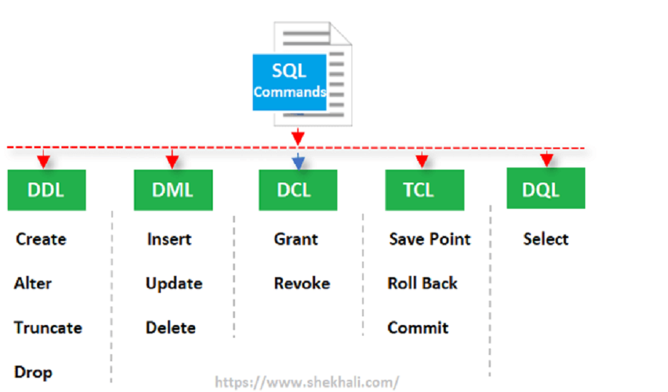
SQL | DDL, DQL, DML, DCL and TCL Commands
DDL – Data Definition Language (create, alter, drop, truncate)
DQL – Data Query Language
DML – Data Manipulation Language((Insert, update, delete, select)
DCL – Data Control Language
TCL – Transaction Control language

Slide 8
Create : To Create a database we use the command : Syntax : Create database [database name] ex. Create database Company.
CREATE

Slide 9
Create By using the CREATE TABLE statement.
Create : To Create a database we use the command
Syntax :
CREATE TABLE TABLE_NAME
(
Column_name1 datatype,
Column_name2 datatype,
Column_name3 datatype
)

Slide 10
Alter :Using Alter command we can make changes in the table such as add a column, drop a column or change data type of a column or delete a constraint in a table. Alter Commands Using make changes in the table ADD NEW COLUMN and ALTER COLUMN and DROP COLUMN
 | ADD COLUMN | ALTER COLUMN | DROP COLUMN
SYNTAX | Alter table [Table Name] add [Column Name 1] [Data Type] , …[Column Name n] | Alter table [Table Name] Alter Column [Column Name ] [ new Data Type] | Alter Table [Table Name] Drop Column [Column Name ]
EXAMPLE | Alter Table Student Add School Name Varchar(100) | Alter Table Student Alter Column Marks INT | Alter Table Student Drop Column Marks

Slide 11
Drop TABLE
Removes all rows along with structure of table.
Syntax : Drop table Table_Name
Example: Drop table Employee

Slide 12
Insert
To insert data inside a table in two syntax are there
Syntax :
Insert Into [Table Name] Values( column1_value, column2_value,…….)
Example :
Insert Into Emp_details Values(1,'Amit','Pune',10000)
For Required Column
Syntax:
Insert Into Table_name (Required Column1, Column2) Values (Value1, Value2)
Example:
Insert Into Emp_details (Id, Name) Values (1, 'Amit')

Slide 13
Update
To update the values in the table
Syntax :
Update Table_name Set Col_name1 = Newvalue1,col_name2=newvalue2
Where Condition
Example :
Update Employee Set Salary= 50000 Where Empid=1

Slide 14
Delete : To Remove The Records From The Table
Syntax: Delete From Table_name Where Condition
It Will Delete Those Records Which Matches The Condition.
Example :
Delete From Student Where Rollno=1
------------------------------------------------------------------------------ Syntax:To Delete All The Records from Table
Delete From Table_name
Example:
Delete from Student

Slide 15
Truncate : Removes All Rows From A Table
Syntax-
Truncate Table Table_name
Example-
Truncate Table Student

Slide 16
Select
To view the records of the table
Syntax:
Select * From Table_name
Select * From Table_name Where Condition
Example:
Select * From Student
Select * From Students Where Rollno > 100

Slide 17
Aggregate functions
Function | Use
SUM | Gives The Total Sum Of A Numeric Column
MIN | Gives The Minimum Value In A Set of Values
MAX | Gives The Maximum Value In A Set of Values
AVG | Gives The Average Value Of A Numeric Column
COUNT | Returns The Number Of Rows That Match The Specific Criteria

Slide 18
Min()
Min() Function Gives The Smallest Value
Syntax- Select Min(col_name) From Table_name
Example- Select Min(totalmarks) From Student

Slide 19
Max()
Max() Function Gives The Maximum Value
Syntax- Select Max (Col_name) From Table_name
Example – Select Max(totalmarks) From Student

Slide 20
Constraints in SQL

Slide 21
Types of constraints
Unique
Not null
Primary key
Foreign key
Default
Check

Slide 22
UNIQUE
The Unique constraint ensures that all values in a column are different
In a table there can be multiple unique columns
Syntax:
COLNAME DATATYPE CONSTRAINT CONSTRAINT_NAME UNIQUE
Example:
MOBILE VARCHAR(10) CONSTRAINT UK_MOBILE UNIQUE

Slide 23
NOT NULL
The Not null constraint enforces a column to Not accept NULL values
Syntax:
COLNAME DATATYPE CONSTRAINT CONSTRAINT_NAME NOT NULL
Example:
EMAIL VARCHAR(100) CONSTRAINT NN_MOBILE NOT NULL

Slide 24
PRIMARY KEY = UNIQUE + NOT NULL
The PRIMARY KEY constraint uniquely identifies each record in a table.
Primary keys must contain UNIQUE values, and cannot contain NULL values.
A table can have only ONE primary key
SYNTAX-
COLNAME DATATYPE CONSTRAINT CONSTRAINT_NAME PRIMARY KEY
EXAMPLE –
ROLLNO INT CONSTRAINT PK_ROLLNO PRIMARY KEY
Or
ROLLNO INT IDENTITY(1,1) CONSTRAINT PK_ROLLNO PRIMARY KEY

Slide 25
FOREIGN KEY
Is used to create relationship between two tables.
SQL server is a relational database management system.
That relation is done by putting a common column between two tables and create parent and child table relationship
Syntax:
COLNAME DATATYPE CONSTRAINT CONSTRAINT_NAME FOREIGN KEY REFERENCES PARENT_TABLE (COLNAME)
Example:
ROLLNO INT CONSTRAINT FK_ROLLNO FOREIGN KEY REFERENCES STUDENT(ROLLNO)

Slide 26
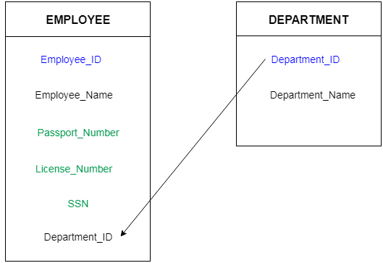
Relation between two tables
Conditions-
Parent table should contains PRIMARY KEY and an other table contains FOREIGN KEY
One common column should be present in both tables
Datatype should be the same of that common column

Slide 27
DEFAULT
The DEFAULT constraint is used to provide a default value for a column.
The default value will be added to all new records IF no other value is specified
Syntax:
COLNAME DATATYPE CONSTRAINT CONSTRAINT_NAME DEFAULT (VALUE)
Example:
SALARY FLOAT CONSTRAINT DF_SALARY DEFAULT( 10000)

Slide 28
CLAUSES

Slide 29
Clauses In Sql Server
SELECT (we can use to read the table or database)
WHERE (we can use operators in where clause)
ORDER BY (we can use for sorting data asc and desc manner)
DISTINCT (we can use for eliminates all duplicate records for the result set)
TOP (we can use for only selects the first n records)
GROUP BY (we can use for grouping data )
HAVING (we can use for restricts the results of a group by )
ROLLUP
CUBE

Slide 30
SELECT
Syntax:
SELECT * FROM [ TBL_NAME]
Example:
SELECT * FROM EMPLOYEE

Slide 31
WHERE
Syntax:
SELECT * FROM <TBL_NAME> WHERE (CONDITION)
Example:
SELECT * FROM EMPLOYEE WHERE ID=10

Slide 32
OPERATORS IN WHERE CLAUSE
IN
IT IS USED TO SEARCH MULTIPLE RECORDS RECORDS IN WHERE CONDITION
Example:
SELECT * FROM EMP WHERE NAME IN (‘CLAIR’)
SELECT * FROM EMP WHERE AGE IN (34,45)

Slide 33
OPERATORS IN WHERE CLAUSE
LIKE
IT IS USED TO SEARCH THE PATTERN MATCHING
Example:
SELECT * FROM EMP WHERE NAME LIKE ‘A%’
(DISPLAY THOSE EMP NAME WHOSE NAME STARTS WITH A)
SELECT * FROM EMP WHERE NAME LIKE ‘%A’
(DISPLAY THOSE EMP NAME WHOSE NAME ENDS WITH A)

Slide 34
WILDCARDS IN SQL
WILDCARDS
% - IT CAN ACCEPT ANY CHARACTER ANY NO OF TIME
_ - IT CAN ACCEPT ANY CHARACTER BUT ONLY ONCE

Slide 35
OPERATORS IN WHERE CLAUSE
NOT
Example:
SELECT * FROM EMP WHERE JOB! =’ANALYST’
(DISPLAY ALL EMP NAME EXCEPT ANALYST)

Slide 36
OPERATORS IN WHERE CLAUSE
BETWEEN
Example:
SELECT * FROM EMP WHERE SALARY BETWEEN 10000 AND 55000
(DISPLAY THOSE RECORDS WHOSE SALARY IN BETWEEN 10000 AND 55000, BOUNDRY VALUES ARE INCLUSIVE)

Slide 37
ORDER BY
ORDER BY
IT IS USED TO SORT THE DATA IN ASCENDING AND DESCENDING MANNER
Syntax:
SELECT * FROM <TBL_NAME> ORDER BY <COL_NAME> (ASC/DESC)
Example:
SELECT * FROM EMP ORER BY SALARY DESC

Slide 38
DISTINCT
DISTINCT
IT IS USED TO GIVE DISTINCT VALUES
Syntax:
SELECT DISTINCT <COL_NAME>FROM <TBL_NAME>
Example:
SELECT DISTINCT NAME FROM EMP

Slide 39
TOP
TOP
IT IS USED TO FINDING THE TOP RECORDS IN YOUR TABLE
Syntax:
SELECT TOP N* FROM <TBL_NAME>
Example:
SELECT TOP 2* FROM EMP

Slide 40
GROUP BY
GROUP BY
IT IS USED GROUPING SIMILAR DATA BASED ON COLUMN
Syntax:
SELECT (COL_NAME) AGGREGATE FUNCTION FROM (TBL_NAME)
GROUP BY (COL_NAME)

Slide 41
HAVING
HAVING
-IT IS USED TO FILTER THE RECORDS AFTER GROUPING THE DATA
-IT IS USED ALONG WITH GROUP BY
Syntax:
SELECT (COL_NAME), FUNCTION_NAME FROM (TBL_NAME)
GROUP BY (COL_NAME)
HAVING (CONDITION)
Example:
SELECT JOB, COUNT (*) FROM EMP GROUP BY JOB HAVING SUM(SALARY)>50000

Slide 42
ALIAS
ALIAS
IT IS AN ALTERNATIVE NAME GIVEN TO THE COLUMN NAME.

Slide 43
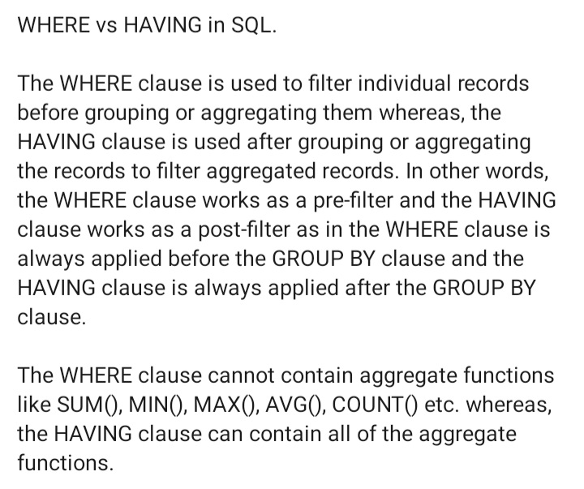
Differences

Slide 44
SQL INSERT INTO SELECT Statement
Copy all columns from one table to another table:
Syntax :
INSERT INTO table2 SELECT * FROM table1
OR
INSERT INTO table2 SELECT * FROM table1 WHERE condition;

Slide 45
SQL INSERT INTO SELECT Statement
Copy only some columns from one table into another table:
Syntax:
INSERT INTO table2 (column1, column2, column3, ...) SELECT column1, column2, column3, ... FROM table1 WHERE condition;

Slide 46
SQL INSERT INTO SELECT Statement
INSERT INTO PAST (NAME,CITY,MOBILE)
SELECT NAME, CITY,MOBILE FROM COPY
WHERE CID=1
INSERT INTO PAST SELECT * FROM COPY
(DO NOT USE IDENTITY FOR SECOND TABLE)

Slide 47
JOINS AND TYPES
What is join?
-To retrieve the information from multiple tables.
- it is allow us to combine rows from two or more tables based upon related column.
What are the different types of join?
-mainly 4 types of joins are there

Slide 48
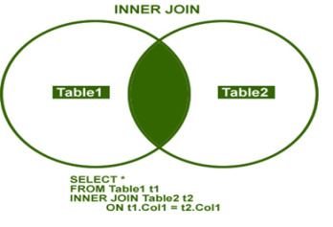
INNER JOIN
Retrieve common records from both table

Slide 49
INNER JOIN
It gets the common records from both the tables.
For two table:
Syntax:
Select * from table1 inner join table2 on table1.colname (p.k) = table2.colname (f.k)
Example:
Select * from country inner join state on country.countryid = state.countryid

Slide 50
OUTER JOIN
It displays the result set containing all the rows from one table and matching rows from other table
Outer Join is further divided into following types:
1.Left outer join
2.Right outer join
3.Full outer join

Slide 51
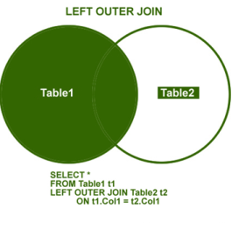
LEFT OUTER JOIN
Common record from both table+all records from left side table

Slide 52
LEFT OUTER JOIN
It gets the Common records from both the tables + all records from left tables.
Syntax:
Select * from Table1 (Left) LEFT OUTER JOIN Table2 ON Tabl1.Column_name (P.K.) = Table2.Column_name (F.K.)
Example:
Select * from COUNTRY left outer join STATE on COUNTRY.COUNTRYID = STATE.COUNTRYID

Slide 53
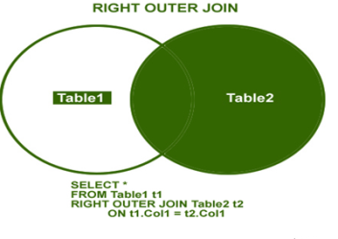
RIGHT OUTER JOIN
Common record from both table+all records from right side table

Slide 54
RIGHT OUTER JOIN
It is used to obtained match records from both of the tables along with unmatched records from right table
Syntax:
Select * from Table1 (Left) RIGHT OUTER JOIN Table2 ON Tabl1.Column_name (P.K.) = Table2.Column_name (F.K.)
Example:
select e.EmployeeId,e.name,ed.deptname,ed.role from Empdetails ed right outer join Employee on e.EmployeeId=ed.EmployeeId

Slide 55
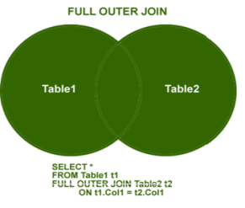
FULL OUTER JOIN
Common record from both table + non matching records from right and left side table

Slide 56
FULL OUTER JOIN
It is combination of left outer join &right outer join this join returns all the matching & non matching rows from both table.
Syntax:
Select * from Table1 (Left) FULL OUTER JOIN Table2 ON Tabl1.Column_name (P.K.) = Table2.Column_name (F.K.)
Example:
Select e.EmployeeId,e.name,ed.deptname,ed.role from Employee e full outer join Empdetails ed on e.EmployeeId=ed.EmployeeId

Slide 57
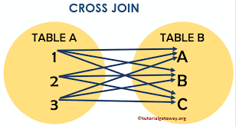
CROSS JOIN

Slide 58
CROSS JOIN
In CROSS JOIN Each record from first table will be merge with all the records from second table.
you don't need any condition to perform cross join.
The product of rows M * N rows.
Syntax:
Select * from <table_no1> CROSS JOIN <table_no2>
Example
Select * from Emp1 CROSS JOIN Emp2

Slide 59
SELF JOIN
Joining a table data by itself it is called as SELF JOIN.
SELF JOIN is worked on single table
Self join is classified as
Inner self join
Outer self join (Left, Right, Full)
Cross self join
when we compare column value within a data same table then it is called as self mechanism.

Slide 60
Union Operator
The Union Operator Is Used to Combine the result Set of two or more select statements
Each select statement within Union must have the same number of columns
The columns in each select statement must also be in the same order
The column must also have similar data type

Slide 61
Union Syntax
Select Column_name() From Table1
Union
Select Column_name() From Table2;
Note : the Union operator select only distinct values by default.
To allow duplicate values use union all

Slide 62
Union Syntax
Select Column_name() From Table1
Union all
Select Column_name() From Table2;

Slide 63
Intersect operation
It is used to combine two SELECT statements. The intersect operation returns the common rows from both SELECT statements.
In the intersect operation, the number of datatype and column must be the same.
It has no duplicates and it arranges the data in ascending order by default.
Syntax:
SELECT column_name FROM table 1
INTERSECT
SELECT column_name FROM table 2

Slide 64
Minus operation
It combines the result of two SELECT statements. Minus operator is used to display the rows which are present in the first query but absent in the second query.
It has no duplicates and data arranged in ascending order by default.
Syntax:
SELECT column_name from table1
MINUS
SELECT column_name from table2

Slide 65
T-SQL
Transact- Structured Query Language
T-SQL code can be stored within Microsoft SQL Server database by using T-Sql routines such as Store Procedure, Triggers and Functions
Lessons in this chapter:
Lesson 1: Designing and Implementing Stored Procedures
Lesson 2: Implementing User-Defined Functions
Lesson 3: Implementing Triggers

Slide 66
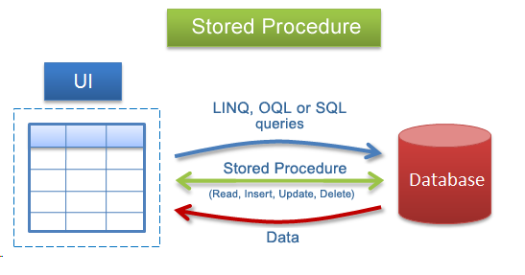
STORED PROCEDURE
What is stored procedure?
Why it is used?

Slide 67
What is a Stored Procedure?
A stored procedure is a prepared SQL code that you can save, so the code can be reused over and over again.
So if you have an SQL query that you write over and over again, save it as a stored procedure, and then just call it to execute it.

Slide 68
Important features of stored procedures:
They can be called from T-SQL code by using the EXECUTE command.
You can pass data to them through input parameters, and receive data back through output parameters.
They can return result sets of queries to the client application.
They can modify data in tables.

Slide 69
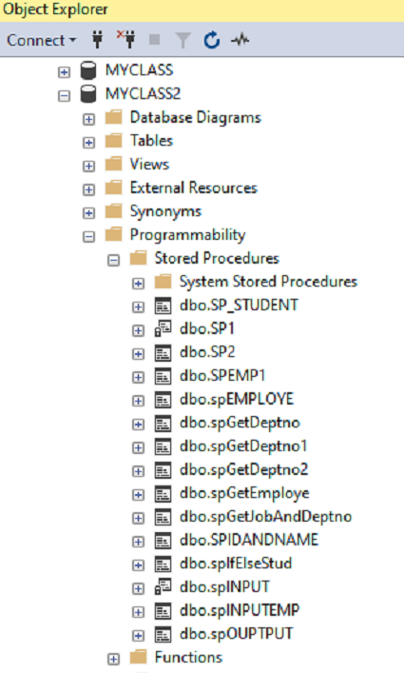
SYNTAX TO CREATE STORED PROCEDURE:
Create Procedure Procedure_name
(
Parameter 1 Datatype,
Parameters 2 Datatype,
Parameter 3 Datatype
)
As
Begin
Statement
End

Slide 70
SYNTAX FOR CALLING STORED PROCEDURE:
ways to execute or call stored procedure
Sp_name
Exec sp_name parameters.
Execute sp_name parameters

Slide 71
Types of Stored Procedures
User Defined Stored procedure: The user defined stored procedures are created by users and stored in the current database
System Stored Procedure: The system stored procedure has names prefixed with sp_. Its manage SQL Server through administrative tasks. Which databases store system stored procedures are master and msdb database. E.g. : sp_rename
Temporary Stored procedures: The temporary stored procedures have names prefixed with the # symbol. Temporary stored procedures stored in the tempdb databases. These procedures are automatically dropped when the connection terminates between client and server.

Slide 72
Types of Stored Procedures
Remote Stored Procedures: The remote stored procedures are procedures that are created and stored in databases on remote servers. These remote procedures can be accessed from various servers
Extended Stored Procedures:These are Dynamic _link libraries (DLL’s)that are executed outside the SQL Server environment . They are identified by the prefix xp_

Slide 73
Parameters in Stored Procedure
Two types of parameters used in Stored Procedure
1) Input Parameters
2)Output Parameters
(If you have to modify the structure of your stored procedure then instead of create you can use ALTER command)

Slide 74
RETURN (Transact-SQL)
Exits unconditionally from a query or procedure. RETURN is immediate and complete and can be used at any point to exit from a procedure, batch, or statement block.

Slide 75
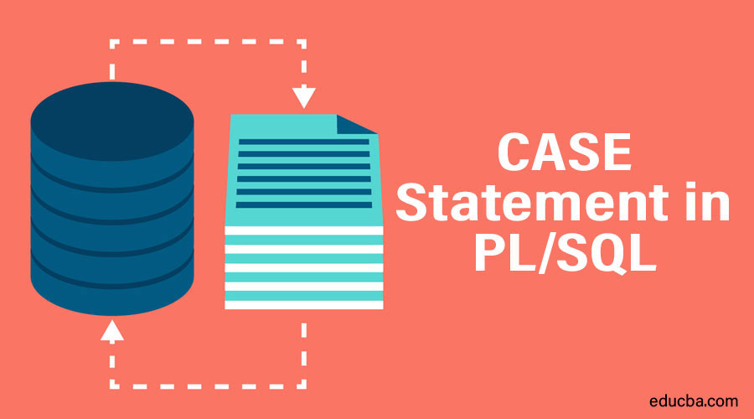
CASE statements
How to use CASE statement in SQL?

Slide 76
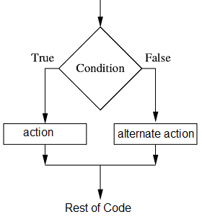
SQL Server IF ELSE Statement By Exam
IF
ELSE

Slide 77

TRIGGERS

Slide 78
Trigger
A trigger is A special kind of A stored procedure that executes in response to certain action on the table like insertion, deletion or updating of data.
It is a database object which is bound to a table and is executed automatically.

Slide 79
Types Of Triggers
Basically, triggers are classified into two main types:-
DML trigger(insert, update, delete)
DDL trigger (create, alter, drop)
LOGON trigger
CLR Triggers

Slide 80
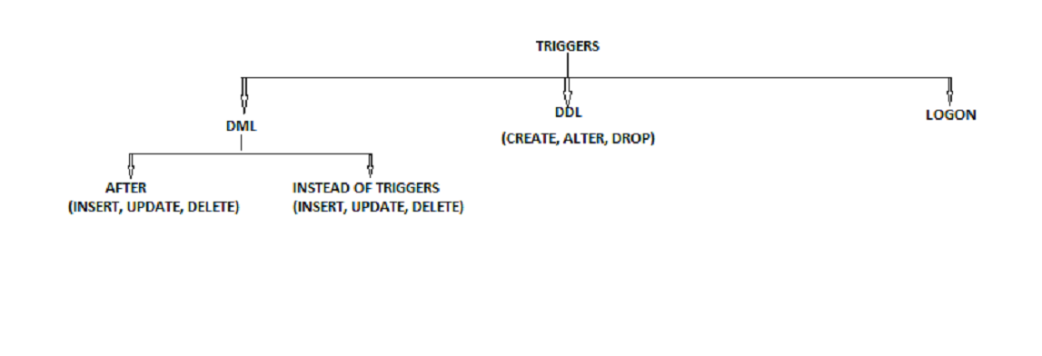
TRIGGERS

Slide 81
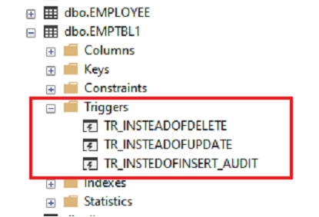
Insert:
Syntax:
Create trigger trigger_name
on tablename
For insert
As
Begin
statement
End

Slide 82
Update
Syntax:
Create trigger trigger_name
on tablename
For update
As
Begin
statement
End

Slide 83
Delete
Syntax:
Create trigger trg_delete
on tablename
For delete
As
Begin
statement
End

Slide 84
Instead Of Trigger
These can be used as an interceptor for anything that anyone tried to do on our table or view.
If you define an instead of trigger on a table for the delete operation, they try to delete rows, and they will not actually get deleted (unless you issue another delete instruction from within the trigger)
A. INSTEAD INSERT trigger. B. INSTEAD UPDATE trigger. C. INSTRAD DELETE trigger

Slide 85
Insert
Syntax:
Create trigger trigger_name
on table_name
Instead of Insert
As
Begin
print 'you are not allow to insert any data on table'
End

Slide 86
Update:
Syntax:
Create trigger trigger_name
on table_name
Instead of update
As
Begin
print 'cant update'
End

Slide 87
Delete:
Syntax:
Create trigger trigger_name
on table_name
Instead of delete
As
Begin
print 'cant delete'
End

Slide 88
Dropping a DML trigger
Syntax :
DROP TRIGGER Trigger_name

Slide 89
ENABLE / DISABLE TRIGGER
All the triggers can be enabled/disabled on the table using the statement
ALTER TABLE Employee_Test {ENABLE|DISBALE} TRIGGER ALL
Specific Triggers can be enabled or disabled as:-
ALTER TABLE table_name {ENABLE| DISABLE} TRIGGER triggername

Slide 90
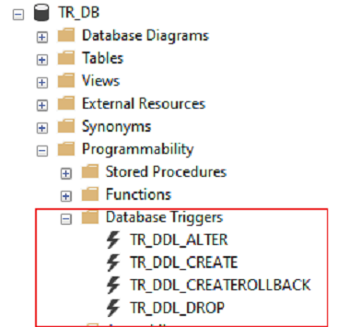
DDL Triggers
Syntax:
Create trigger trigger_name
on database
For CREATE_TABLE
As
Begin
Print 'new table created'
End

Slide 91
DDL Trigger
Syntax:
Create trigger trigger_name
on Database
For ALTER_TABLE
As
Begin
Print 'you have just alter a table'
End

Slide 92
DDL Trigger
Syntax:
Create trigger trigger_name
on Database
For DROP_TABLE
As
Begin
Print 'you have just drop a table'
End

Slide 93
Drop DDL Trigger
Syntax:
Drop trigger trigger_name on database

Slide 94
LOGON Trigger
Logon triggers are special type of trigger that fire when LOGON event of SQL Server is raised.
Syntax:
create trigger trigger_name
On all server
For logon
As
Begin
statement
End

Slide 95
FUNCTIONS
It is a set of instruction or block of a code which is used to program specific task.
There are two types of functions.
1. User defined function.
2. In-built function
Types of user define functions
1. Scaler Valued Function
2. Table Valued Function

Slide 96
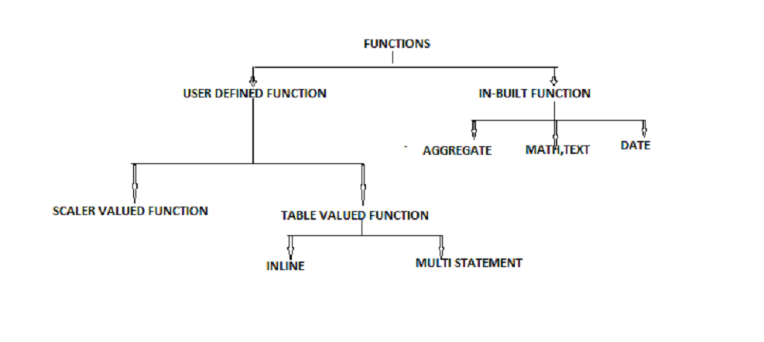
Functions

Slide 97
Syntax of Function
Create function function_name
(
Parameter1 datatype,
Parameter2 datatype
)
RETURNS DATATYPE
AS
BEGIN
STATEMENTS
RETURN VALUE
END

Slide 98
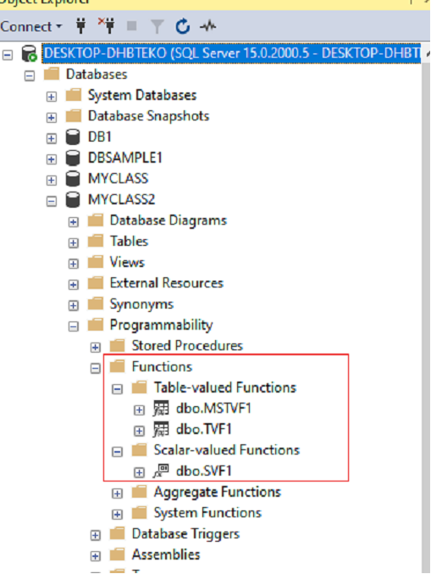
SYNTAX FOR CALLING A FUNCTION
SELECT dbo.functionname('Parameter1')
Function can stored in programmability folder.
Expand programmability folder, under that functions folder
is present

Slide 99
Function VS Stored Procedure
Function | Stored Procedure
The function must return a value | but in Stored Procedure it is optional.
2. Functions can have only input parameters for it | 2. whereas Procedures can have input or output parameters.
3. Function can call with SELECT statement | 3. Stored procedure call with EXECUTE statement
4. Functions can only have input parameters | 4. Stored procedure have input or output parameters

Slide 100
Function Examples
Example of scaler valued function
Create function fn_add
(
@n1 int,
@n2 int
) returns INT
AS
BEGIN
Declare @tot int
Set @tot= @n1 + @n2
Return @tot
End

Slide 101
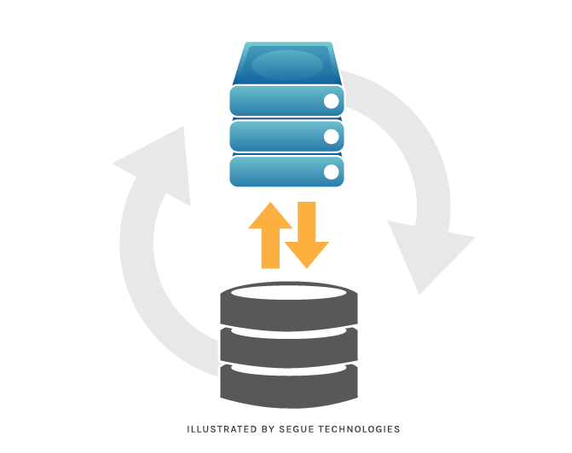
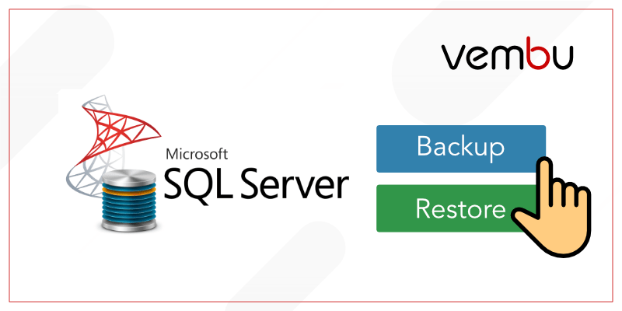
Sql Backup and Restore

Slide 102
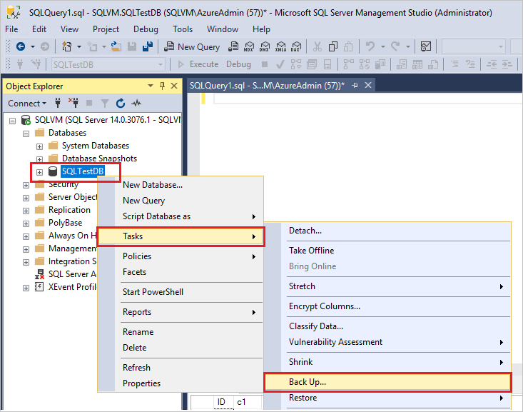
Sql Backup

Slide 103
SQL BACKUP DATABASE for SQL Server
Syntax :
BACKUP DATABASE testDB TO DISK = 'D:\backups\testDB.bak';

Slide 104
SQL RESTORE DATABASE for SQL Server SQL RESTORE DATABASE for SQL Server
Syntax:
RESTORE DATABASE ENOSIS
FROM DISK = 'D:\backups\ENOSIS.bak'

Slide 105
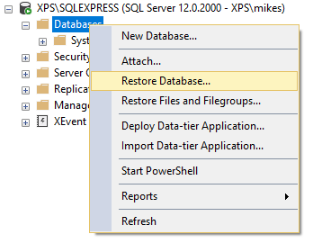
Sql Restore

Slide 106
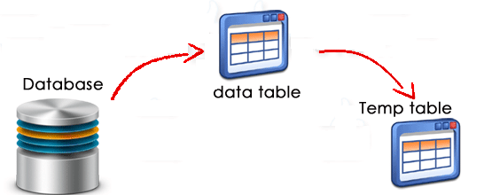
TEMPORARY TABLE
What is temporary table?

Slide 107
Temporary Tables
Different Types of Temporary Tables
SQL Server provides two types of temp tables based on the behavior and scope of the table. These are:
Local Temp Table
Global Temp Table

Slide 108
Local Temp Table
Local temp tables are only available to the current connection for the user; and they are automatically deleted when the user disconnects from instances. Local temporary table name is stared with hash ("#") sign.
The syntax given below is used to create a local Temp table:
CREATE TABLE #LocalTempTable
(
UserID int,
UserName varchar (50),
UserAddress varchar (150)
)

Slide 109
Insert And Select
Insert into #LocalTempTable values (1, 'Abhijit’, ‘India');
Now select records from that table:
Select* from #LocalTempTable

Slide 110
Global Temp Table
Global Temporary tables name starts with a double hash ("##"). Once this table has been created by a connection, like a permanent table it is then available to any user by any connection. It can only be deleted once all connections have been closed.
The scope of Global temporary table is the same for the entire user for a particular connection. We need to put "##" with the name of Global temporary tables.

Slide 111
Below is the syntax for creating a GLOBAL Temporary Table:
TABLE ##NewGlobalTempTable
(
UserID int,
UserName varchar (50),
UserAddress varchar (150)
)

Slide 112
Insert And Select
Insert into ##NewGlobalTempTable values (1, 'Abhijit’, ‘India');
Now select records from that table:
Select * from ##NewGlobalTempTable

Slide 113
VIEWS
View is a virtual table consist of columns from one or more table
View Is Virtual/Logical Table For The Base Table.
View is an object derived the data from one or more table.
Types Of View
1.Simple View
2.Complex View

Slide 114
Simple view
When we Access The Req. Data From From A Single Base Table
It Can Support All DML Operations(Insert,Update,Delete)
Simple View Is Also Called As Updatable View
Syntax:
Create View <View Name> As Select * From <Table Name >[Where Condition]

Slide 115
Complex view
When We Access The req Data From Multiple Base Tables.
It Does Not Support All DML Operations On Multiple Base Tables At a time.
Are Also Called Non –Updatable Views.
Syntax:
Create View <View Name> As Select * From <Table Name >,<Table Name>

Slide 116
INDEXES
SQL CREATE INDEX Statement
Indexes are used to retrieve data from the database more quickly than otherwise. The users cannot see the indexes, they are just used to speed up searches/queries.

Slide 117
CREATE INDEX Syntax
CREATE INDEX index_name ON table_name (column1, column2, ...);
Creates an index on a table. Duplicate values are allowed:

Slide 118
CREATE UNIQUE INDEX Syntax
CREATE UNIQUE INDEX index_name ON table_name (column1, column2, ...);
Creates a unique index on a table. Duplicate values are not allowed:

Slide 119
DROP INDEX Statement
The DROP INDEX statement is used to delete an index in a table.
DROP INDEX table_name.index_name;

Slide 120
ERROR HANDLING
Implements error handling for transact sql that is similar to the exception handling in the Microsoft visual c# and java languages
Error handling in SQL Server gives us control over the Transact-SQL code.
For example, when things go wrong, we get a chance to do something about it
Exception handling are used to handle errors raised in the program while execution due to wrong data etc.
If there is no error occurred in try block then catch block will not be executed

Slide 121
Syntax of error handling
Syntax :
BEGIN TRY
SQL STATEMENTS
END TRY
BEGIN CATCH
SQL STATEMENTS
END CATCH

Slide 122
Example
BEGIN TRY
SELECT 10/0;
SELECT * FROM Customers
END TRY
BEGIN CATCH
PRINT 'YOU CAN NOT DIVIDE BY 0'
END CATCH

Slide 123
Retrieving Error Information
Error_Number() : Returns the number of the error.
Error_Severity() :Returns the Severity.
Error_State(): Returns the error state Number.
Error_Procedure():Returns the name of the Store Procedure or trigger
Where the error occurred.
Error_Line(): Returns the Line number inside the routine that caused the error.
Error_Message(): Returns the complete text of the error message.

Slide 124
ERROR HANDLING
Syntax :
BEGIN TRY
{SQL_statement | statement_block}
END TRY
BEGIN CATCH
[{sql_statement | statement_block}]
END CATCH

Slide 125

TRANSACTION
Why we should need transaction?
to control your transactions
to perform some operation/action/task
ex- Banking sector transaction term is use
- for deposit money
- for withdraw money
- for transfer money

Slide 126
TRANSACTION
To control the data these terms are used
Begin Tran : Start of the transaction
Commit Tran : Everything is perfect commit, save all the commands
Rollback Tran : Error, rollback to start position
Savepoint - It is used to create a temporary memory for the values which we want to conditionally cancelled.

Slide 127
When to use transaction?
In batch processing, where multiple rows must be inserted, updated, or deleted as a single unit
Whenever a change to one table requires that other tables be kept consistent
When modifying data in two or more databases concurrently
In distributed transactions, where data is manipulated in databases on various servers

Slide 128

Syntax
Syntax:
Begin transaction
SQL queries
Commit transaction--permanent save in table
Rollback transaction --undo / to cancel operation

Slide 129
Examples
PERFORM TRANSACTION
START TRANSACTION WITH BEGIN
------------------------------------------------------------------------------------
Begin transaction
insert into Customers values ('Sujeet',21,'pune',40000)
insert into Customers values ('Ketan',19,'Mumbai',30000)
----------------------------------------------------------------------------------------
Begin transaction
Rollback transaction -- undo / cancel
Begin transaction
Commit transaction -- permanent save in table

Slide 130
Savepoint
IT IS USED TO CREATE A TEMPORARY MEMORY FROM STORE THE VALUE
WHICH WANT TO CONDITIONALLY CANCELLED
BEGIN TRANSACTION
DELETE FROM EMP WHERE ID=20
SAVE TRANSACTION S1
DELETE FROM EMP WHERE ID=30

Slide 131
Transactions and Error Handling
Begin Try
Begin Transaction
insert into Customers values ('Sujeet',21,'Pune',40000)
insert into Customers values ('Ketan',19,'Mumbai',30000)
insert into Customers values ('Varun',20,'Pune',40000)
insert into Customers values ('Kishore',22,'Delhi',60000)
commit Transaction--permanent data save
Print 'Transaction Successfully Done'
End Try
Begin Catch
Rollback Transaction
Print 'Transaction Fail'
Select ERROR_MESSAGE() as [Error Message]
End Catch

Slide 132
SUB QUERIES
A subquery or nested query is query within another sql query .
Used to return data in main query
we write this subquery after where clause
firstly inner query is executed and will pass their result to outer query.
subqueries is always written in brackets.
DML commands are use in subqueries.

Slide 133
Subqueries with the SELECT Statement
Syntax:
SELECT column_name [, column_name ]
FROM table1 [, table2 ]
WHERE column_name OPERATOR
(SELECT column_name [, column_name ] FROM table1 [, table2 ] [WHERE])

Slide 134
Subqueries with the SELECT Statement
Example :
SELECT * FROM CUSTOMERS
WHERE ID IN
(SELECT ID FROM CUSTOMERS WHERE SALARY > 4500) ;

Slide 135
Subqueries with the INSERT Statement
Syntax :
INSERT INTO table_name [ (column1 [, column2 ]) ]
SELECT [ *|column1 [, column2 ]
FROM table1 [, table2 ]
[ WHERE VALUE OPERATOR ]

Slide 136
Subqueries with the INSERT Statement
Example :
INSERT INTO CUSTOMERS_BKP
SELECT * FROM CUSTOMERS
WHERE ID IN
(SELECT ID FROM CUSTOMERS) ;

Slide 137
Subqueries with the UPDATE Statement
Syntax:
UPDATE table SET column_name = new_value
[ WHERE OPERATOR [ VALUE ]
(SELECT COLUMN_NAME
FROM TABLE_NAME)
[ WHERE) ]

Slide 138
Subqueries with the UPDATE Statement
Example :
UPDATE CUSTOMERS
SET SALARY = SALARY * 0.25
WHERE AGE IN (SELECT AGE FROM CUSTOMERS_BKP WHERE AGE >= 27 );

Slide 139
Subqueries with the DELETE Statement
Syntax :
DELETE FROM CUSTOMERS
WHERE AGE IN
(SELECT AGE FROM CUSTOMERS_BKP WHERE AGE >=27 );

Slide 140
USER CREATION AND SECURITY
Server level permission
Database level permission

Slide 141
Fixed Server-Level Roles
To easily manage the permissions in your databases, SQL Server provides several roles which are security principals that group other principals. They are like groups in the Microsoft Windows operating system. Database-level roles are database-wide in their permissions scope.

Slide 142
Fixed Server-Level Roles
sysadmin
Members of the sysadmin fixed server role can perform any activity in the server.
Serveradmin
Members of the serveradmin fixed server role can change server-wide configuration options and shut down the server.

Slide 143
Fixed Server-Level Roles
Securityadmin
Members of the securityadmin fixed server role manage logins and their properties. They can also GRANT, DENY, and REVOKE database-level permissions if they have access to a database
IMPORTANT: The ability to grant access to the Database Engine and to configure user permissions allows the security admin to assign most server permissions. The securityadmin role should be treated as equivalent to the sysadmin role.

Slide 144
Fixed Server-Level Roles
Processadmin
Members of the processadmin fixed server role can end processes that are running in an instance of SQL Server.
Setupadmin
Members of the setupadmin fixed server role can add and remove linked servers by using Transact-SQL statements. (sysadmin membership is needed when using Management Studio.)

Slide 145
Fixed Server-Level Roles
Bulkadmin
Members of the bulkadmin fixed server role can run the BULK INSERT statement.
Diskadmin
The diskadmin fixed server role is used for managing disk files.

Slide 146
Fixed Server-Level Roles
Dbcreator
Members of the dbcreator fixed server role can create, alter, drop, and restore any database.

Slide 147
Fixed Server-Level Roles
Public
Every SQL Server login belongs to the public server role. When a server principal has not been granted or denied specific permissions on a securable object, the user inherits the permissions granted to public on that object. Only assign public permissions on any object when you want the object to be available to all users. You cannot change membership in public. Note: public is implemented differently than other roles, and permissions can be granted, denied, or revoked from the public fixed server roles.

Slide 148
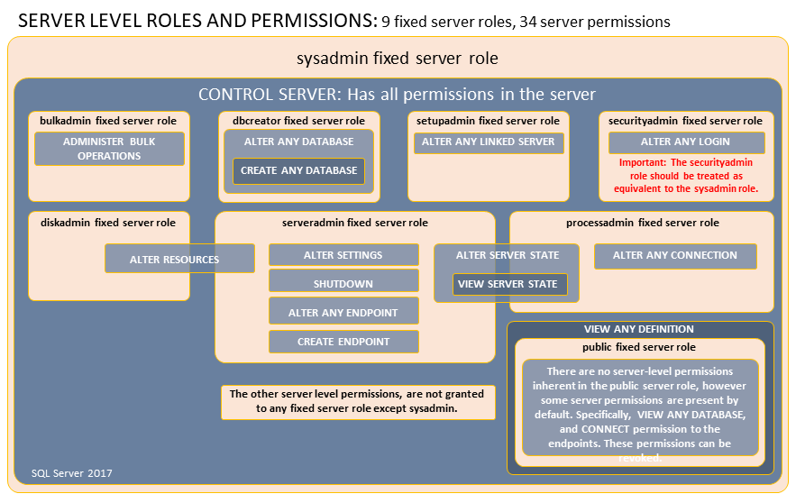

Slide 149

NORMALIZATION
DATABASE NORMALIZATION IS THE PROCESS OF ORGANIZING DATA TO MINIMIZE DATA REDUNDANCY WHICH LEADS TO DATA INCONSISTENCY
DISADVANTAGES
1. DISK SPACE WASTE
2. DATA INCONSISTENCY
3. DML QUERIES CAN BE SLOW

Slide 150
1NF
DATA IN EACH COLUMN SHOULD BE ATOMIC
TABLE DOESNOT CONTAIN ANY REPEATING COLUMN
IDENTIFY EACH RECORD UNIQUELY USING PRIMARY KEY

Slide 151
2NF
TABLE MEETS ALL THE CONDITION OF FIRST FORM
THERE ARE NO PARTIAL DEPENDIES IN THE TABLE
MEANS NON KEY ATTRIBUTE SHOULD NOT BE DEPENDENT ON MORE THAN ONE KEY ATTRIBUTE
MOVE REDUNDENT DATA TO SEPARATE TABLE
CREATE RELATIONSHIP BETWEEN THEM USING FOREIGN KEY

Slide 152
3NF
MEETS ALL THE CONDITIONS OF FIRST AND SECOND NORMAL FORM
TABLE SHOULD NOT HAVE TRANSITIVE DEPENDENCIES IN THEM
IF AN ATTRIBUTE CAN BE DETERMINED BY ANOTHER NON-KEY ATTRIBUTE, IT IS CALLED A
TRANSITIVE DEPENDENCY
IF A NON-KEY ATTRIBUTE CAN BE DETERMINED BY ANOTHER NON-KEY ATTRIBUTE, IT NEEDS TO PUT INTO ANOTHER TABLE

Slide 153
ACID
1. ATOMICITY
If transaction has many operations all should be committed.
2. CONSISTENCY
Operation must be consistent.
3. ISOLATION
Operation that are performed must be isolated from other operation on the same server.
4. DURABILITY
Operation must be saved and store in database permanently.

Slide 154
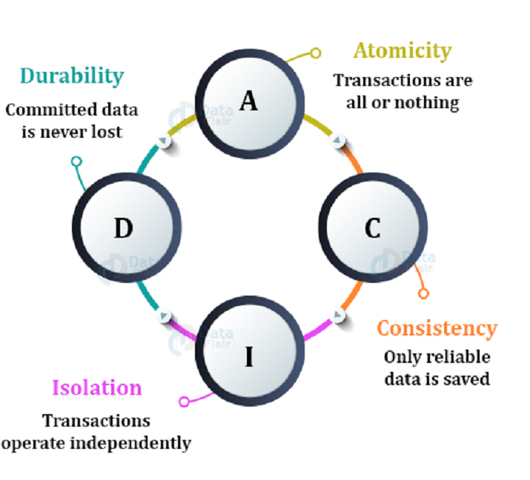

Slide 155
Email Configuration in sql server
Requirements
A local SQL Server Management Studio (SSMS)
SQL Server 2008 or later. In this example, SQL Server 2016 was installed (any edition except the Express edition).
A smartphone with internet access and an email service installed.

Slide 156
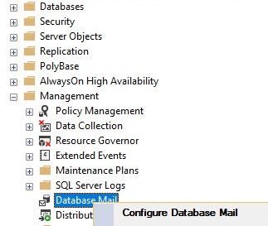
Configure Database Mail in SQL Server
In SSMS, go to Management>Database Mail right click and select the Configure Database Mail option:

Slide 157
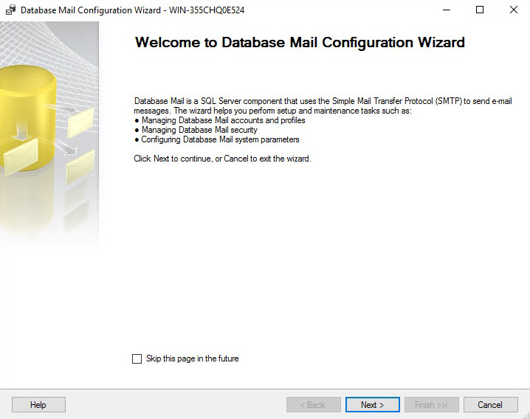

Slide 158
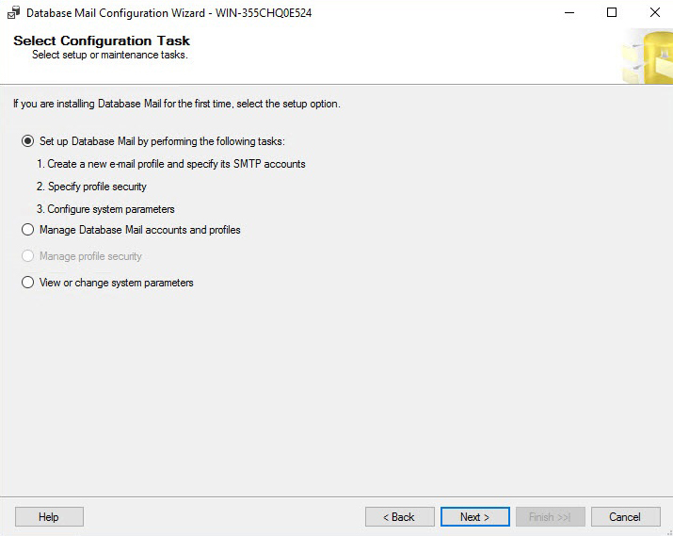
Select the option to Set up mail by performing the following tasks:

Slide 159
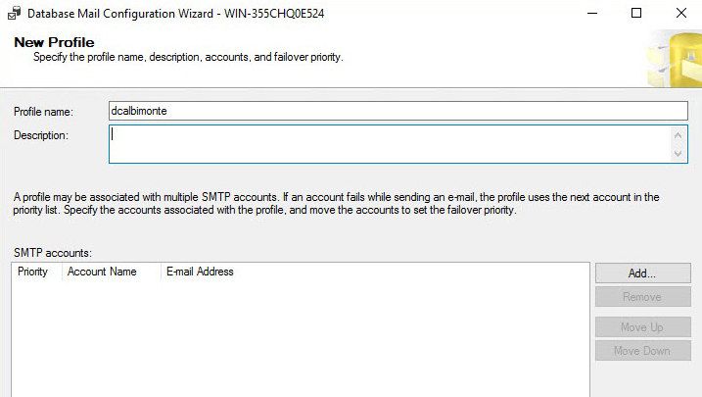
You will specify the profile name here

Slide 160
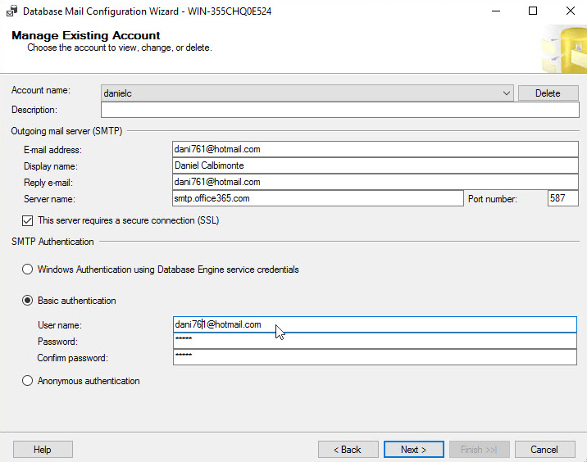
Add Email

Slide 161
Here you have a list of SMTP outgoing services and ports:
Service | Server Name | Port
Outlook | smtp.office365.com | 587 (SSL)
Gmail | smtp.gmail.com | 587 (SSL)
Yahoo | smtp.mail.yahoo.com. | 587 (SSL)

Slide 162
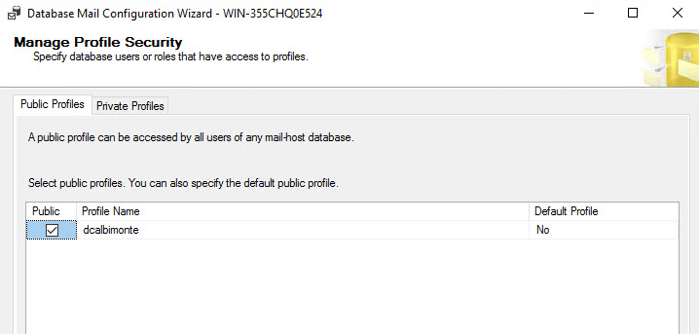
In the next Window, we can convert the profile created to public and to make it the default one

Slide 163
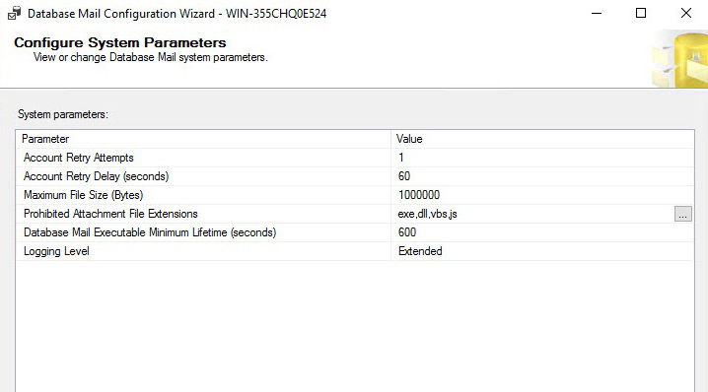
The system parameters can be used to configure the file size, retry attempts, retry delay and then extensions that are now allowed. You can also configure the Logging Level:

Slide 164
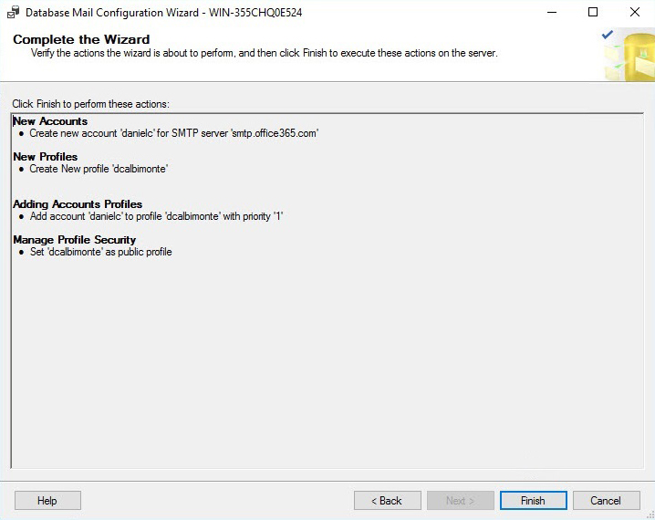
If everything is OK, press Finish:

Slide 165
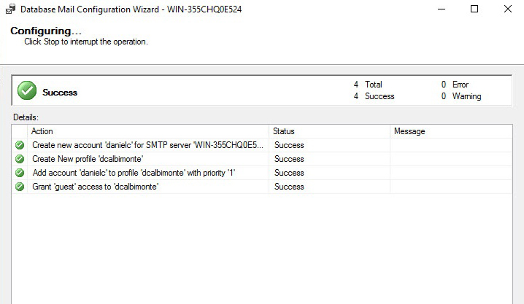
The wizard will verify if the account is created, that the profile is created, that the account is added to the profile and that the access is granted to send mails:

Slide 166
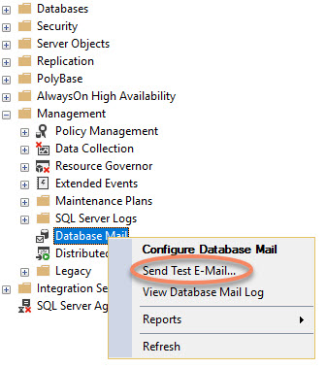
Testing the mail configuration

Slide 167
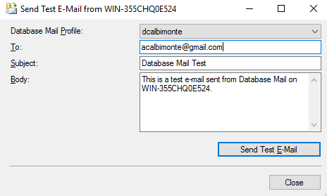
Specify the email to send the test:

Slide 168
Select master database
USE msdb
GO
EXEC sp_send_dbmail @profile_name='ENOSIS’,//Profile name
@recipients='pmohite848@gmail.com’,//user email
@subject='My Test Mail Service.',
@body='Database Mail Received Successfully.'

Slide 169
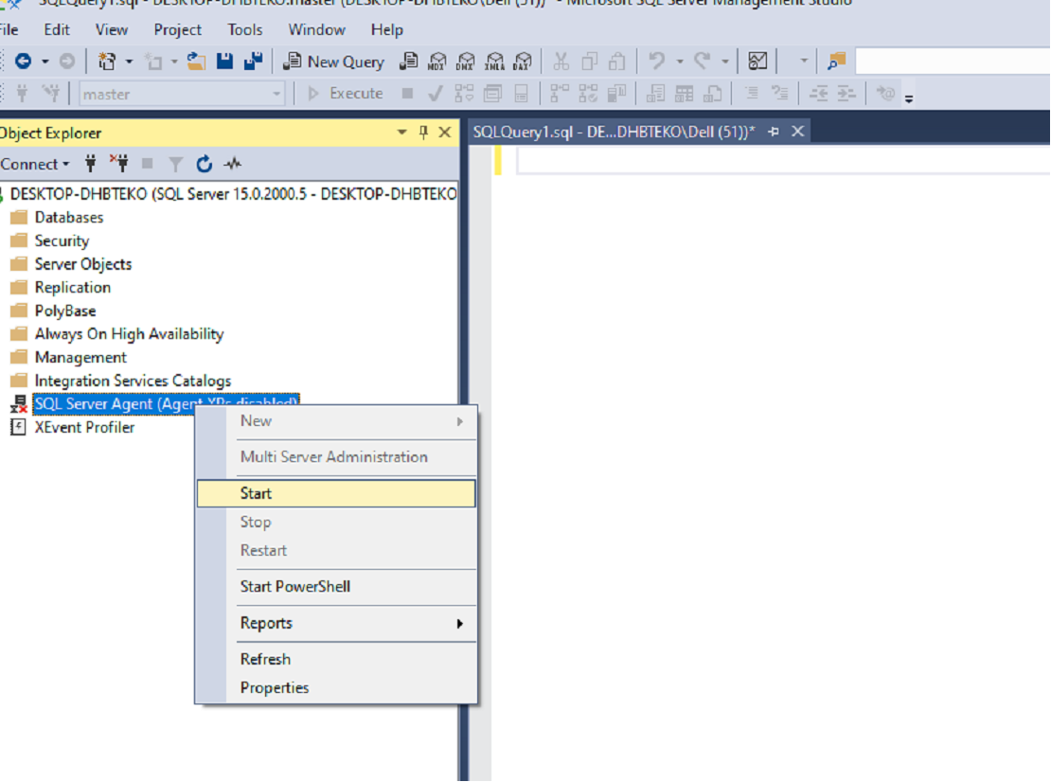
NEED TO START SQL SERVER AGENT BY DEFAULT YOU OPEN SQL SERVER IT IS RED IN COLOUR

Slide 170
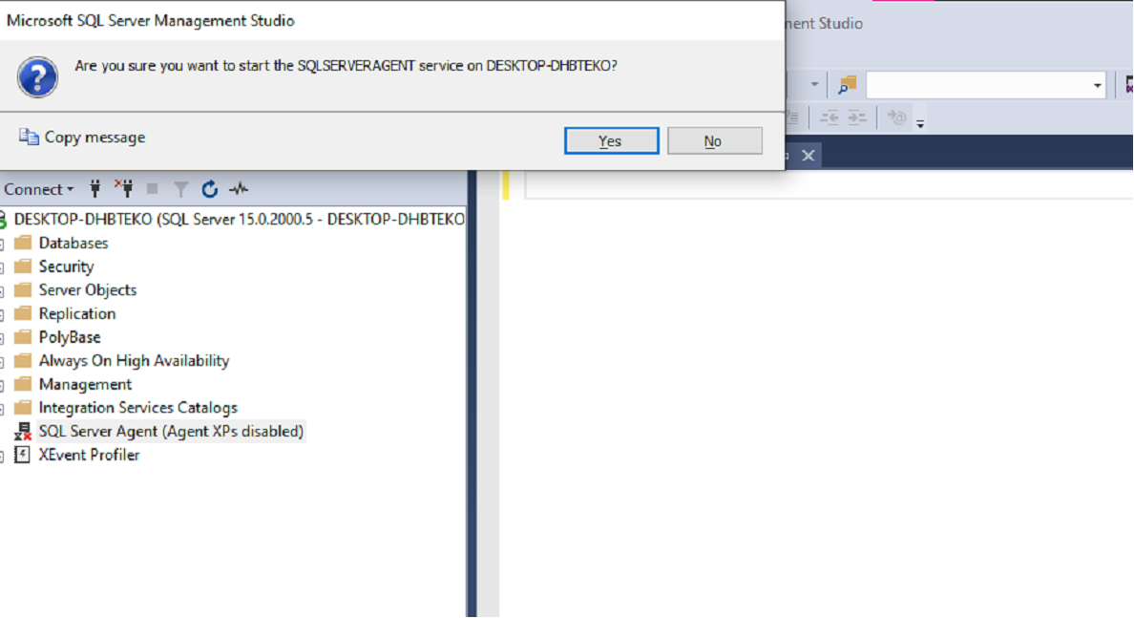
START SQL SERVER AGENT

Slide 171
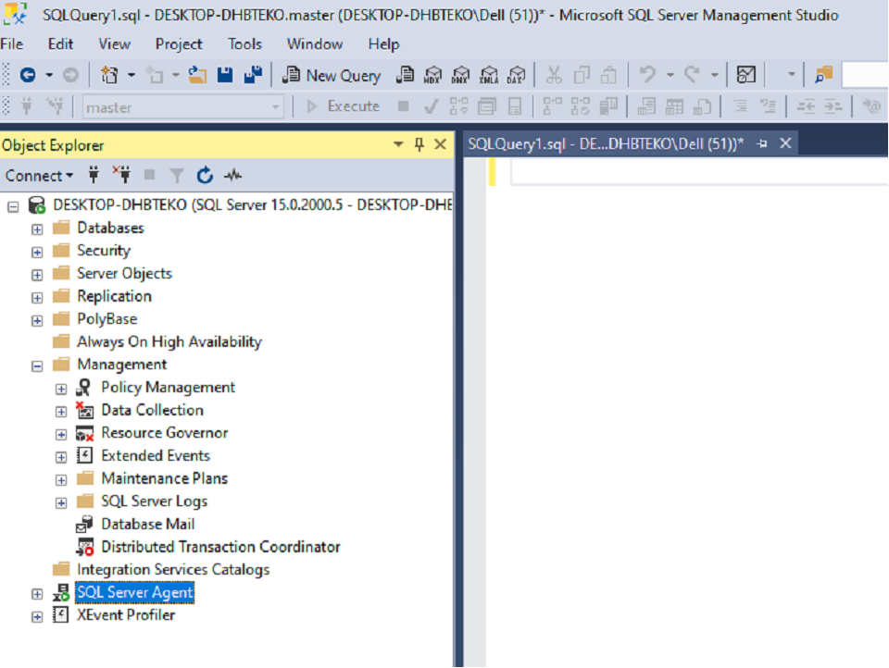
SQL SERVER AGENT IS NOW START

Slide 172
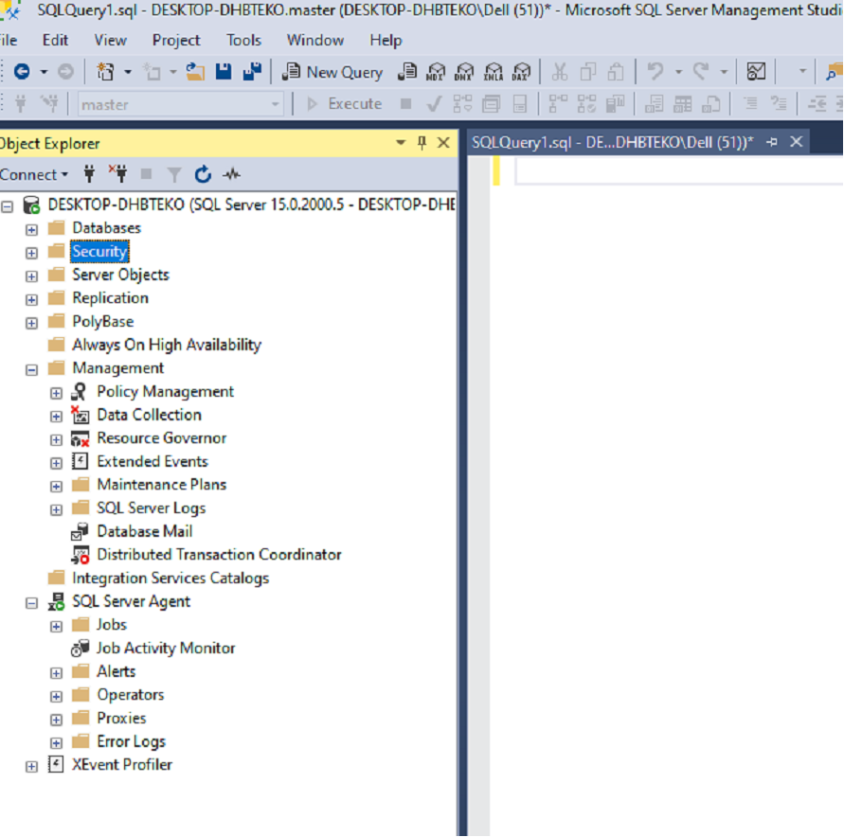
AFTER EXPANDING SQL SERVER AGENT NOW YOU ARE ABLE TO SEE JOBS FOLDER

Slide 173
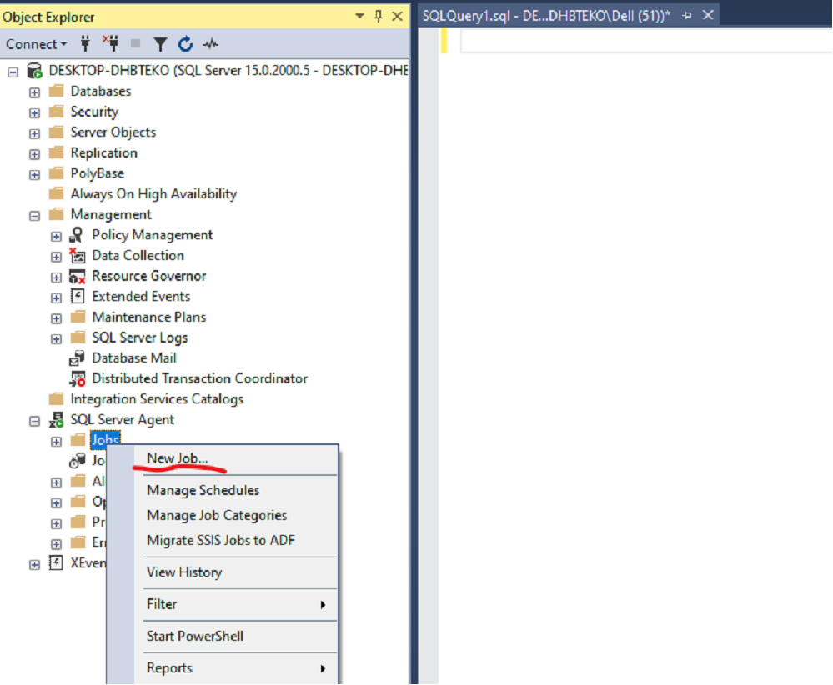
RIGHT CLICK ON JOBS AND SELECT NEW JOB

Slide 174
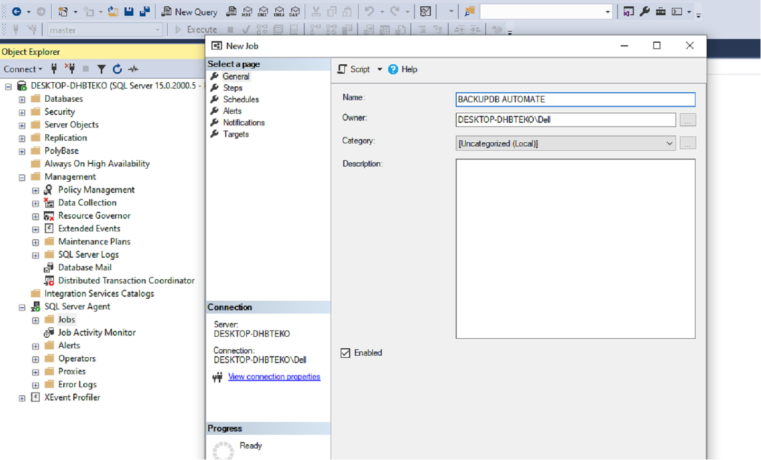
WHATEVER YOU PERFORM SPECIFY HERE , WE NEED TO CREATE BACKUP OF DATABASE

Slide 175
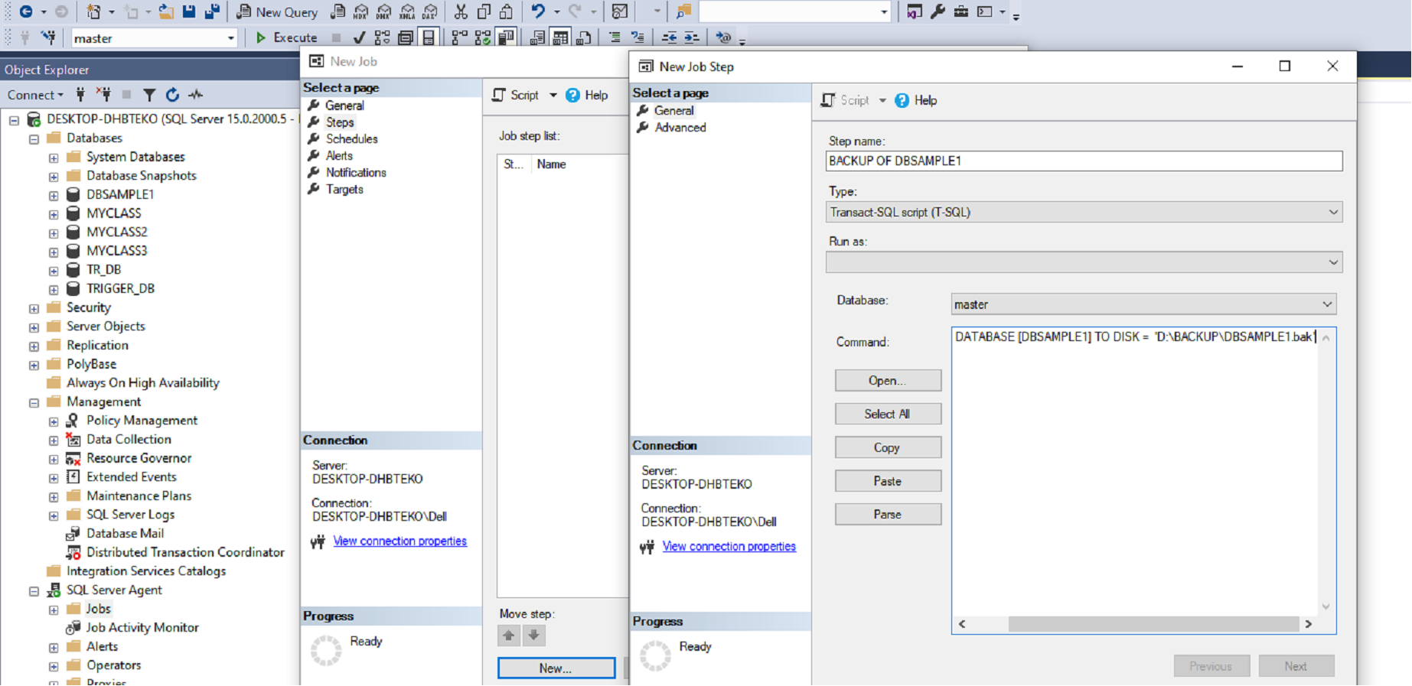
CLICK ON STEP AND MENTION STEP NAME, SYNTAX FOR BACKUP OF DATABASE

Slide 176
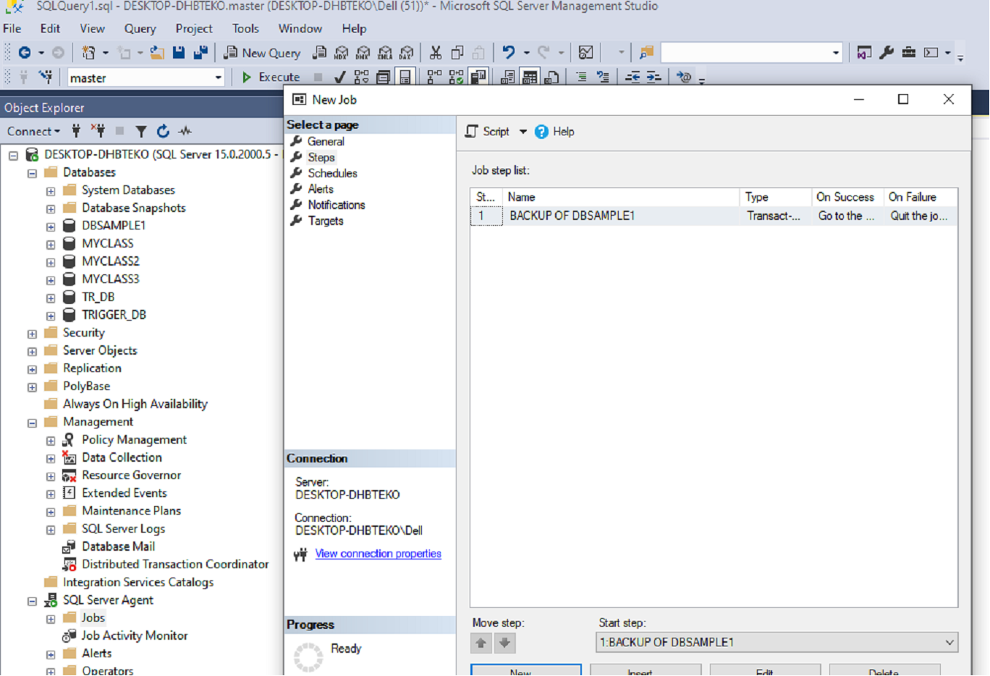

Slide 177
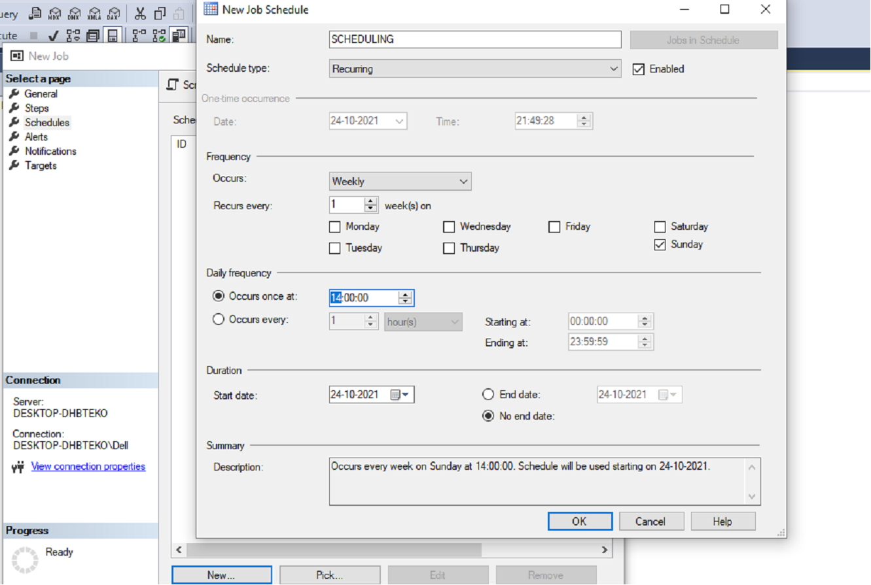
CLICK ON SCHEDULES AND SET THIS WINDOW AND CLICK OK

Slide 178
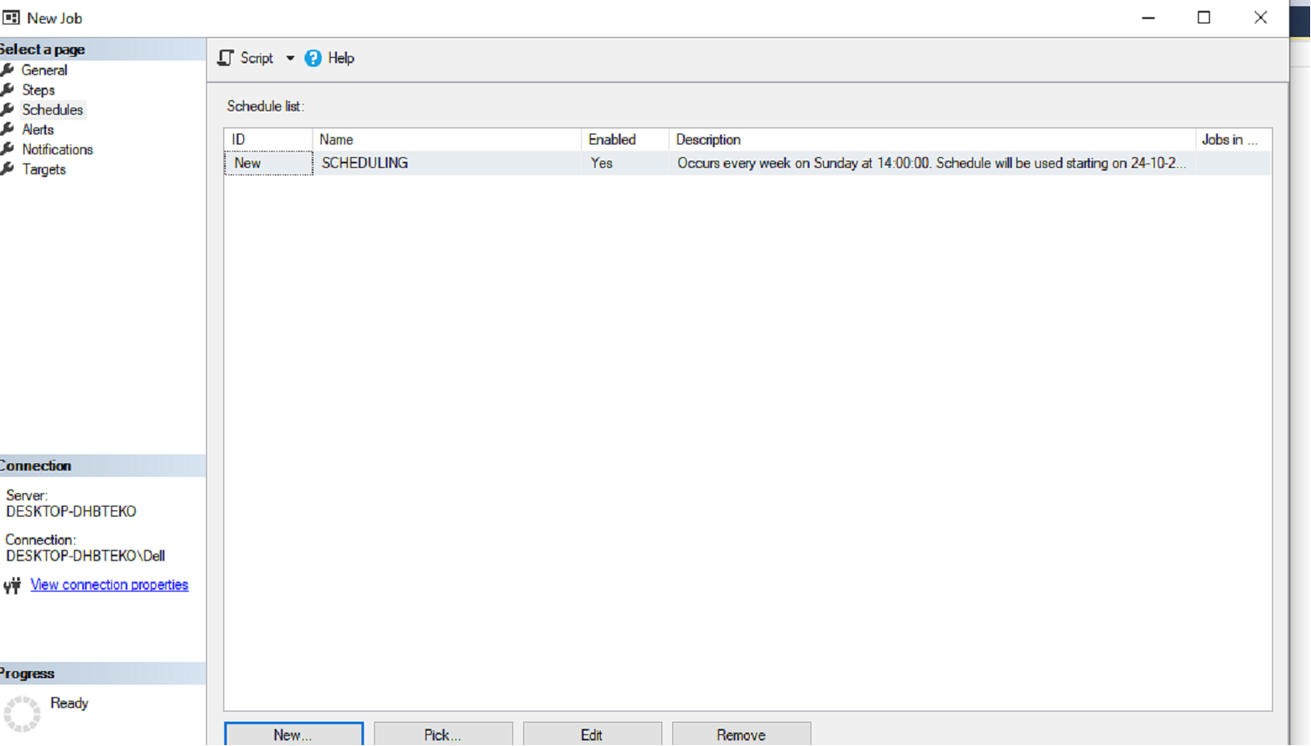

Slide 179
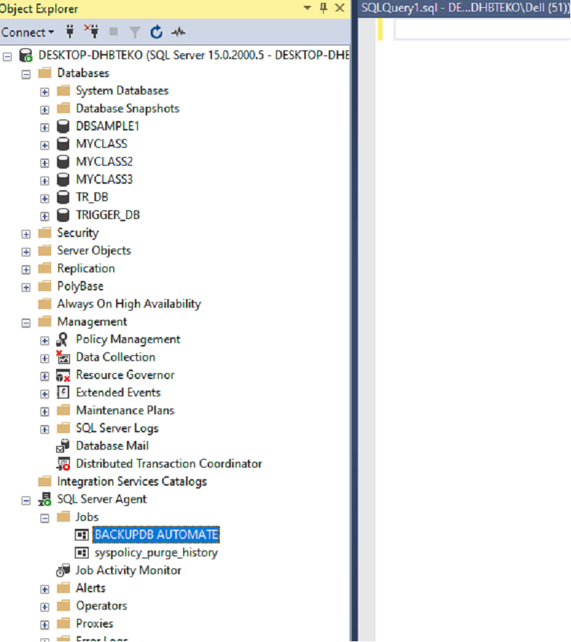
BACKUPDB AUTOMATE JOB IS PRESENT IN SQL SERVER AGENT

Slide 180
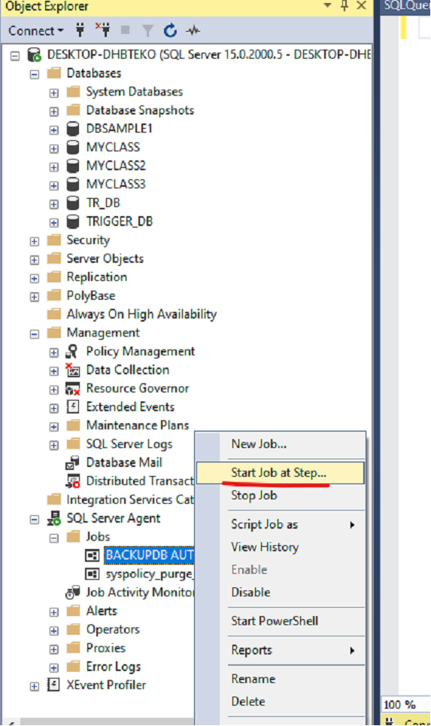
NEED TO START THE JOB

Slide 181
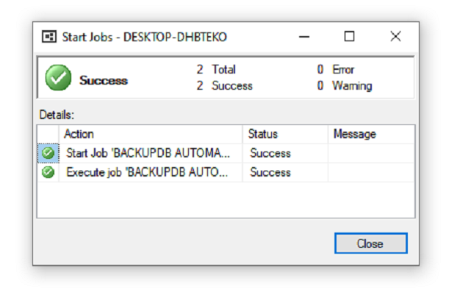

Slide 182
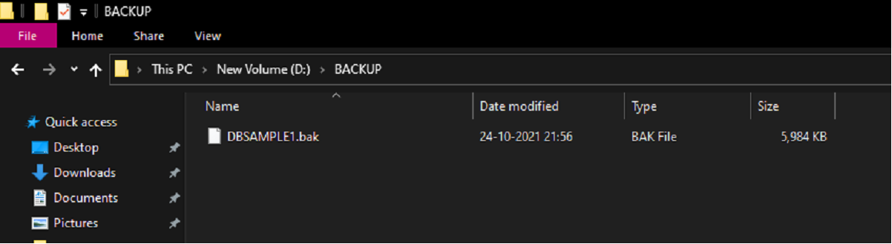
BACKUP OF SAMPLEDB1

Slide 183
THANK YOU

